Slide 1
Cultural Imagery
Gwinnett County is one of the fastest-growing and diverse counties in the United States. Much of this diversity comes from foreign-born residents representing more than 120 different countries and accounting for more than a quarter of the population. The Dominate subject should be imagery celebrating this world-wide cultural diversity.

Slide 2
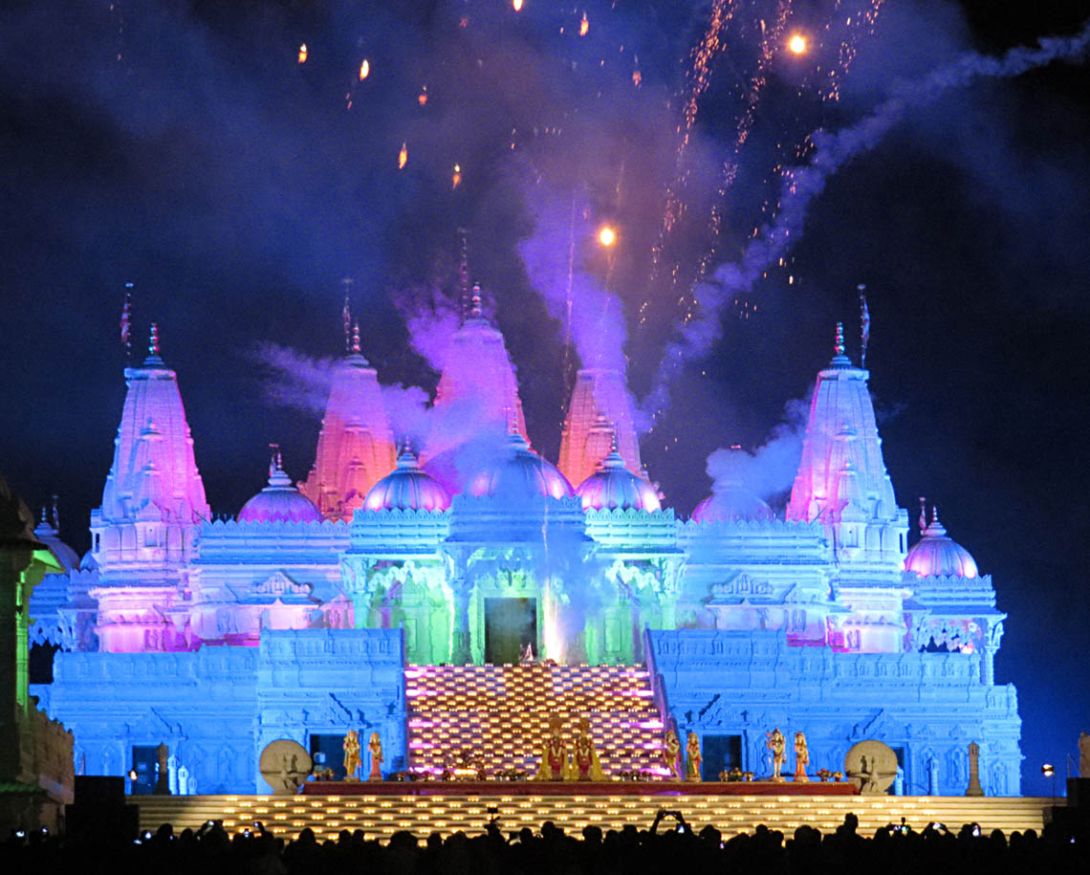
Mikki Root Dillon
Diwali Night
First Place
Judges Comments: Beautiful colors! Experiment with shutter speed for crisper image.

Slide 3
Historic Structures
Dominate subject should evoke the agrarian, industrial or other historic significance of the Southeast Region of the United States and preferably correlate in some way to Gwinnett County history, but not mandatory. Historic Structures may be in an urban setting, for example the Gwinnett Historic Courthouse in downtown Lawrenceville.

Slide 4
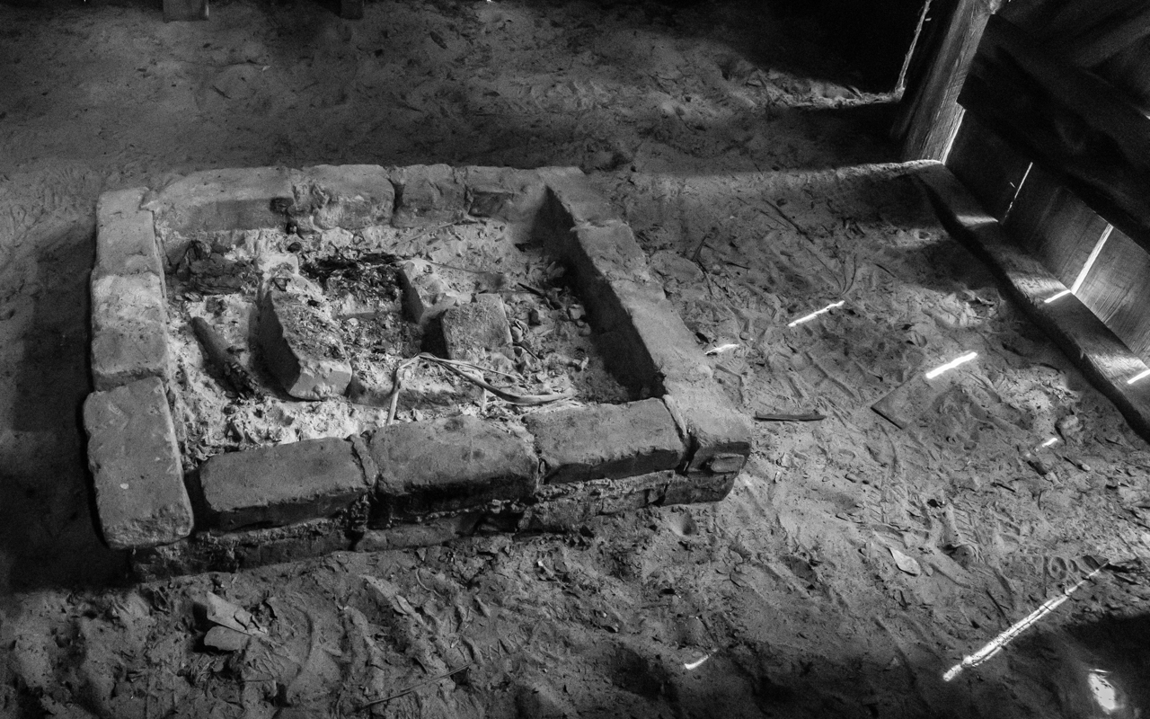
Lee Friedman
Extinguished
First Place
Judges Comments: Dramatic capture! Great light and use of black & white.

Slide 5
Landscapes
Dominate subject must be natural landscapes in the Southeast Region of the United States. This category may not include manmade objects as a significant part of the image, however, incidental manmade objects such as a fence line, or county dirt or gravel road, old barn in far distance may be accepted.

Slide 6
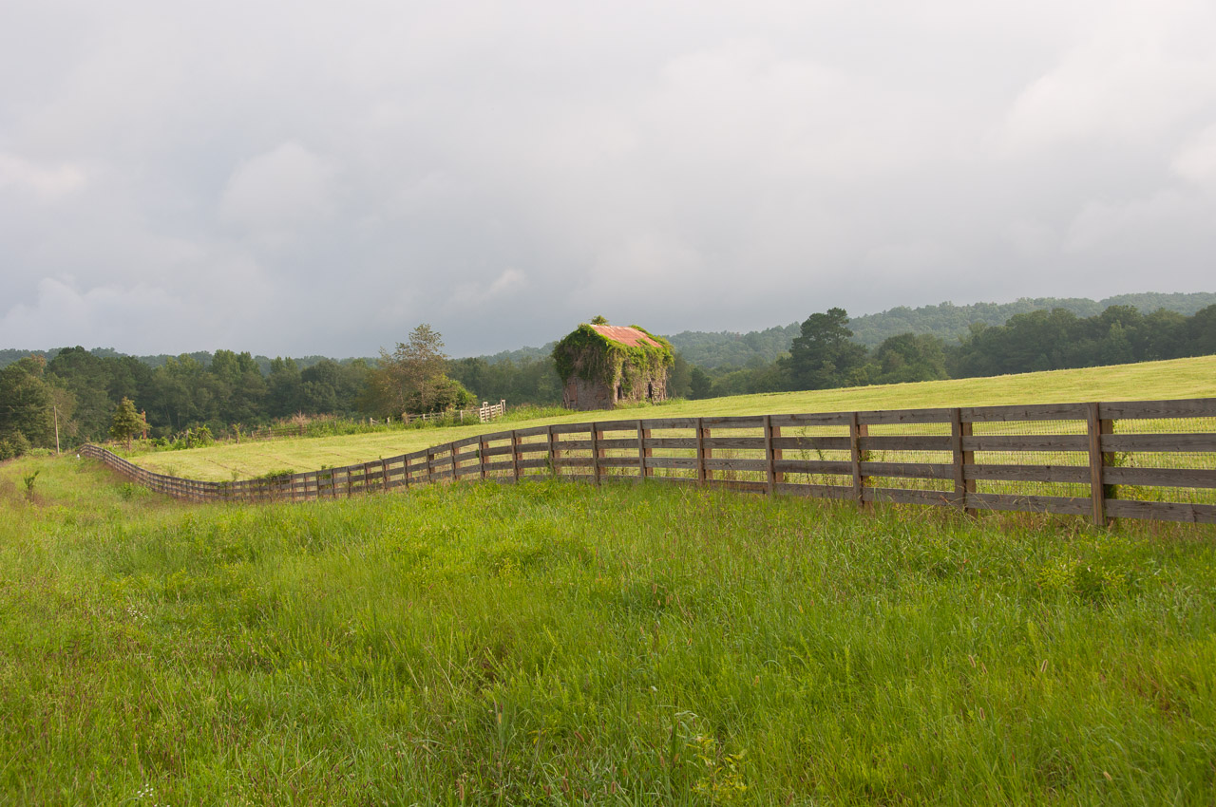
Connie White
Bygone Days
First Place
Judges Comments: Beautiful light, great representation of Georgia!

Slide 7
Native flora
Dominate subject must be native to the Southeast Region of the United States. Plant life can include trees, shrubs, flowers or fungi. The images should emphasize the botanical characteristics and beauty of the species.

Slide 8
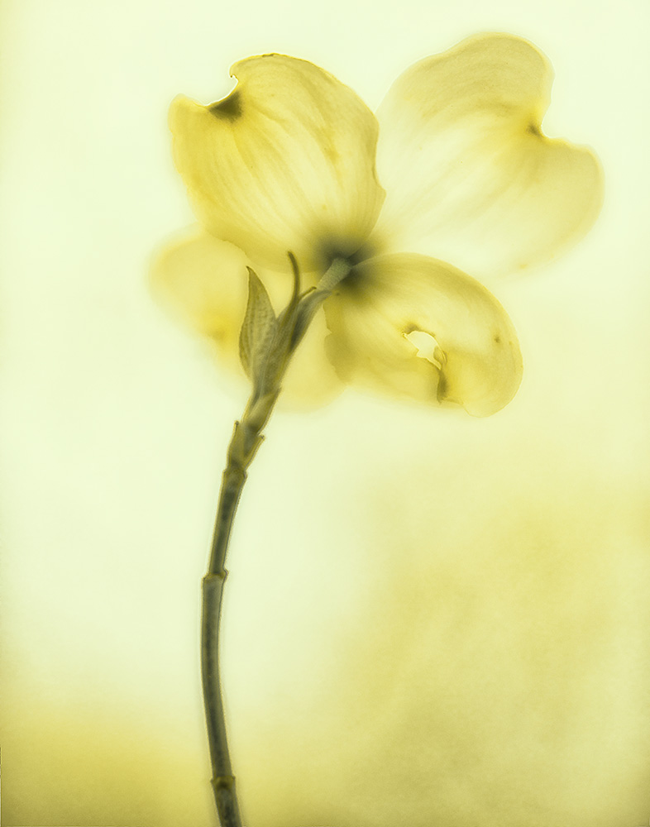
Anna DeStafino
Dogwood
First Place
Judges Comments: Gorgeous! Abstract approach to common Georgia flower. Translucense draws you in and makes me want to stay a while.

Slide 9
Native Wildlife
Dominate subject must be native to the Southeast Region of the United States. All wildlife photographs must be in their natural habitat. No photographs will be accepted of domestic animals or those in captivity and under no circumstances should baiting or enticing wildlife be used to capture the photograph. Can include any mammals, birds, reptiles or insects. Manmade structures in a wildlife photograph will be accepted where these structures support the primary subject i.e.: owls in a barn, birds nesting in the roof of a covered bridge or mill.

Slide 10
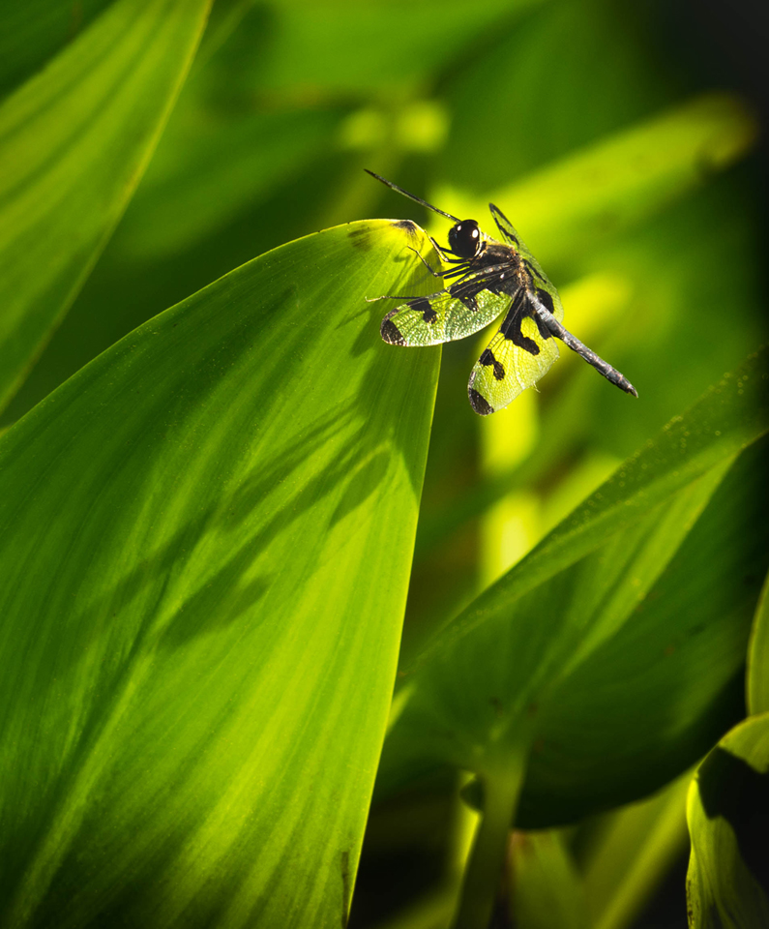
Mikki Root Dillion
Just Resting, Thank You
First Place
Judges Comments: Beautiful – great use of color and composition

Slide 11
People’s choice
From all photographs entered in the 5 categories, viewers were able to submit their ballots.
Everyone who had a photograph in the competition and exhibit should be congratulated. It always amazes me the quality, varitty and caliber of photographs created by our members.
Congratulations to everyone! Well Done!
Here are the Third, Second and First place finishers for People’s Choice.

Slide 12
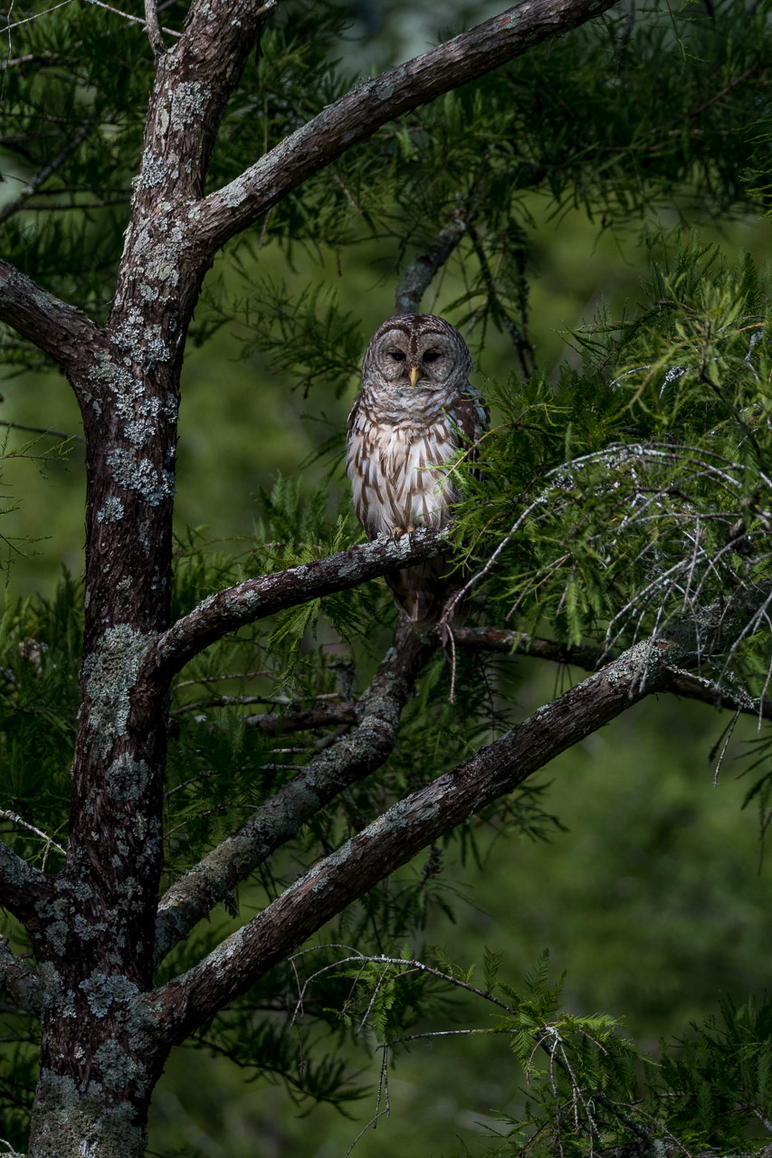
Steve White
Watchin’ You – Native Wildlife
First Place - Peoples Award
Judges Comments: Beautiful detail, great composition.

